Slide 1




GRADE 9-10 · AP PRECALCULUS · UNIT 1
Topic 1.7
Rational Functions
and End Behavior
Journey of 6 stations, 60 minutes
Polynomial and Rational Functions
Mr Malek Thiab
FAITH, RIGHTEOUSNESS AND WISDOM
Notes:
Speaker notes: Welcome to Topic 1.7: Rational Functions and End Behavior.
Timing: 60 minutes (Diagnose 6, Targeted Instruction 18, Practice 12, Production 12, Mastery Gate 6, Smart Production 6). For a 40-minute class scale every station by two thirds.
The journey map on the next slide shows the six stations; in slideshow mode the Morph transition zooms the station circles into the breadcrumb at the top of every later slide.

Slide 2


Today's journey
Six stations. Each one zooms in as we arrive.
Targeted Instruction
18 min
Production
12 min
Smart Production
6 min
2
4
6
1
3
5
Diagnose
6 min
Practice
12 min
Mastery Gate
6 min
FAITH, RIGHTEOUSNESS AND WISDOM
Notes:
Speaker notes: This is the whole map. Walk it left to right: Diagnose (what we already know), Targeted Instruction (Compare the leading terms; Three cases, three pictures; Approaching, crossing, and what an asymptote means), Practice (Practice, Apply, Investigate), Production (cost per batch at a bottling plant), Mastery Gate (three questions to pass), Smart Production (create, then Time to Check).
In slideshow mode the Morph transition animates these circles shrinking into the breadcrumb on later slides; without Morph the slides fade.
Ask the class which station they think will be hardest.

Slide 3
What we are learning
OBJECTIVES
VOCABULARY
Describe end behavior of rational functions.
rational function
end behavior
horizontal asymptote
leading term
degree
limit notation
STANDARDS
LO 1.7.A Describe end behavior of rational functions.
LO 1.7.A
FAITH, RIGHTEOUSNESS AND WISDOM
Mr Malek Thiab · 3
Notes:
Speaker notes: Read the objectives aloud one at a time and have students say which one they feel least sure about.
Vocabulary used today: rational function, end behavior, horizontal asymptote, leading term, degree, limit notation.
Standards are listed on this slide.
The essential question and mathematical practices are not shown because they are not in the project documents; add them from the curriculum map if you want them displayed.

Slide 4
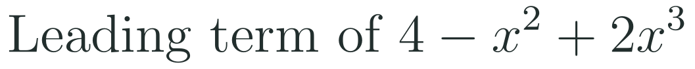
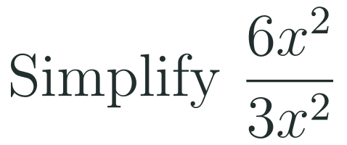
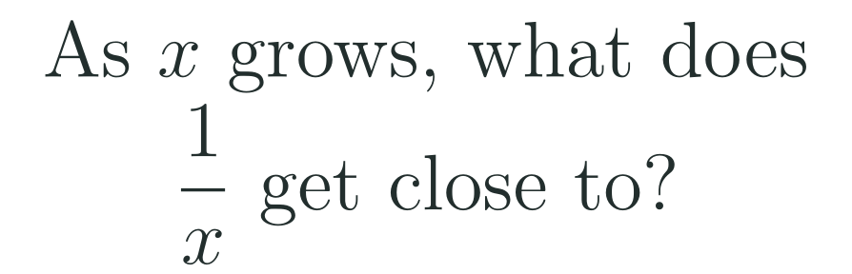
1
2
3
4
5
6
STATION 1 · DIAGNOSE · 6 MIN
Start here: three quick checks
1
2
3
Done when
All three answers are written without a calculator, and you can say what happens to a fraction when its denominator becomes huge.
LO 1.7.A
FAITH, RIGHTEOUSNESS AND WISDOM
Mr Malek Thiab · 4
Notes:
Speaker notes (Diagnose, 6 min, no calculator):
Speaker notes (Diagnose, 6 min, no calculator).
Solutions: Q1 2x^3 (reorder to 2x^3 - x^2 + 4 first). Q2 2. Q3 0 (1/100 = 0.01, 1/1000 = 0.001).
Verbal misconceptions: 'the leading term is the first term written'; 'x^2 over x^2 is x'; '1 over a huge number is huge'.
Adaptive routing: if more than 30% miss Q1, route to slide 5 (leading terms). If Q2 or Q3 is missed by more than 30%, route to slide 6 (three cases).

Slide 5


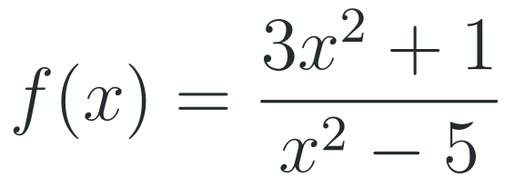
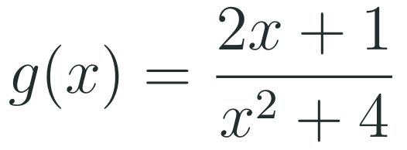
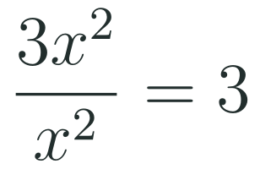
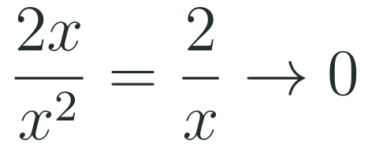
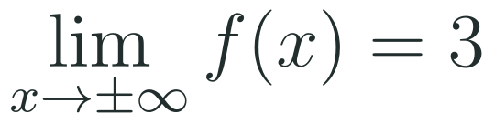
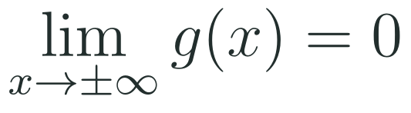
1
2
3
4
5
6
STATION 2 · TARGETED INSTRUCTION · 18 MIN
Compare the leading terms
EXAMPLE A
EXAMPLE B
LO 1.7.A
FAITH, RIGHTEOUSNESS AND WISDOM
Mr Malek Thiab · 5
Notes:
Speaker notes (Targeted Instruction, block 1 of 3):
Speaker notes (Targeted Instruction, block 1 of 3).
Worked solutions: Example A: leading terms 3x^2 and x^2 (the denominator is x^2 - 5, leading term x^2). Ratio 3, so the limit is 3 at both ends and y = 3 is the horizontal asymptote. Example B: leading terms 2x and x^2. The ratio 2x/x^2 = 2/x tends to 0, so the limit is 0 and y = 0 is the horizontal asymptote.
Verbal misconceptions: 'divide every term' (only the leading terms matter far from zero); 'the constant terms decide'.
Adaptive routing: if more than 30% miss Gate Q1, return to this slide and redo Example B aloud.

Slide 6


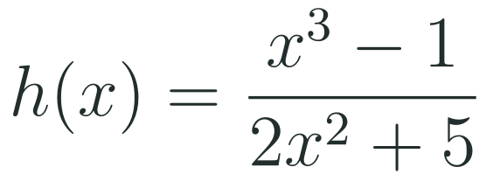
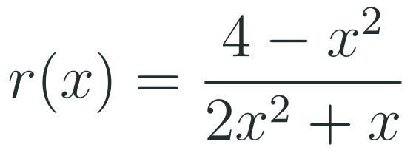
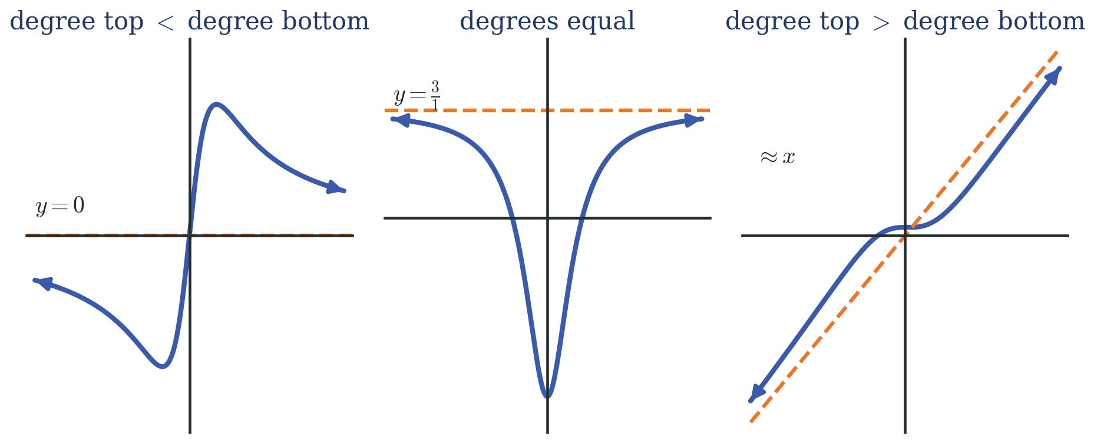
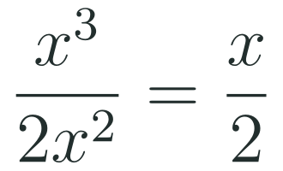
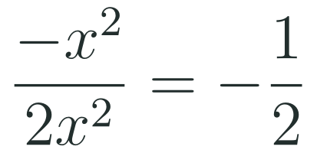
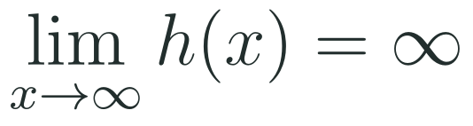
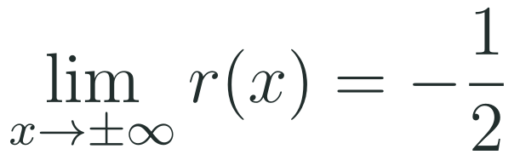
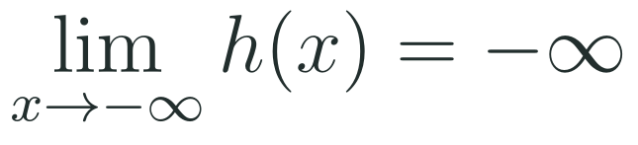
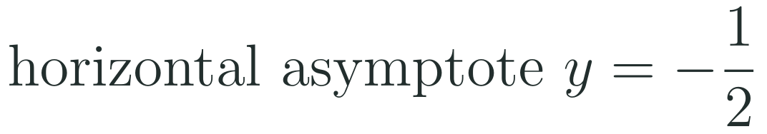
1
2
3
4
5
6
STATION 2 · TARGETED INSTRUCTION · 18 MIN
Three cases, three pictures
EXAMPLE A
EXAMPLE B
LO 1.7.A
FAITH, RIGHTEOUSNESS AND WISDOM
Mr Malek Thiab · 6
Notes:
Speaker notes (Targeted Instruction, block 2 of 3):
Speaker notes (Targeted Instruction, block 2 of 3).
Worked solutions: Example A: numerator degree 3 is greater than denominator degree 2, so the quotient behaves like x/2: it tends to infinity as x tends to infinity and to negative infinity as x tends to negative infinity; there is no horizontal asymptote. Example B: equal degrees; ratio of leading coefficients -1/2, so y = -1/2.
Verbal misconceptions: 'a limit of infinity means a horizontal asymptote at infinity' (no asymptote exists); 'the order of terms in the numerator changes the leading term' (always find the highest power).
Adaptive routing: if more than 30% miss Gate Q2 or Q3, route to this slide and sort the three cases on the board.

Slide 7
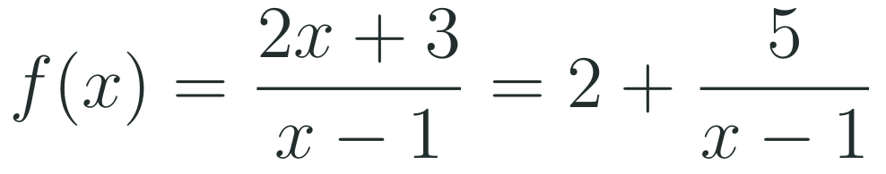
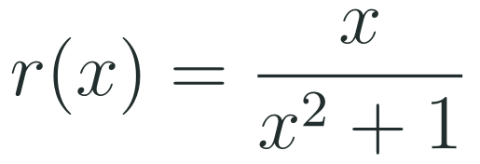
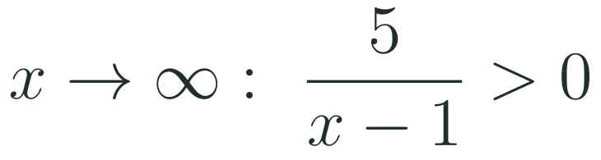
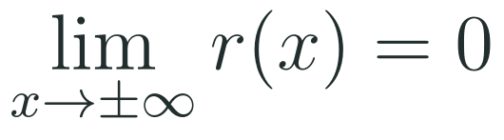
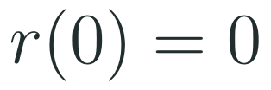

1
2
3
4
5
6
STATION 2 · TARGETED INSTRUCTION · 18 MIN
Approaching, crossing, and what an asymptote means
EXAMPLE A
EXAMPLE B
LO 1.7.A
FAITH, RIGHTEOUSNESS AND WISDOM
Mr Malek Thiab · 7
Notes:
Speaker notes (Targeted Instruction, block 3 of 3):
Speaker notes (Targeted Instruction, block 3 of 3).
Worked solutions: Example A: divide to write (2x + 3)/(x - 1) = 2 + 5/(x - 1). For large positive x, 5/(x - 1) is positive, so f is above 2; for large negative x it is negative, so f is below 2. Example B: degree of the denominator is larger so the limit is 0, but r(0) = 0, so the graph meets its own horizontal asymptote at the origin.
Verbal misconceptions: 'the graph can never touch a horizontal asymptote' (it can; the asymptote only describes the far ends); 'approach from above at both ends'.
Adaptive routing: if more than 30% of students say the graph cannot touch y = 0, show Example B on the calculator before the Gate.

Slide 8
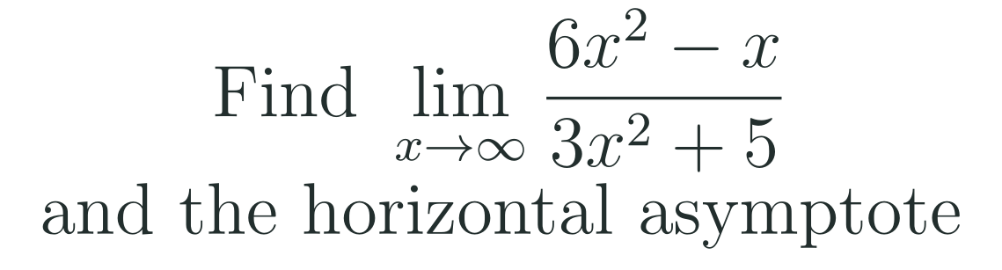
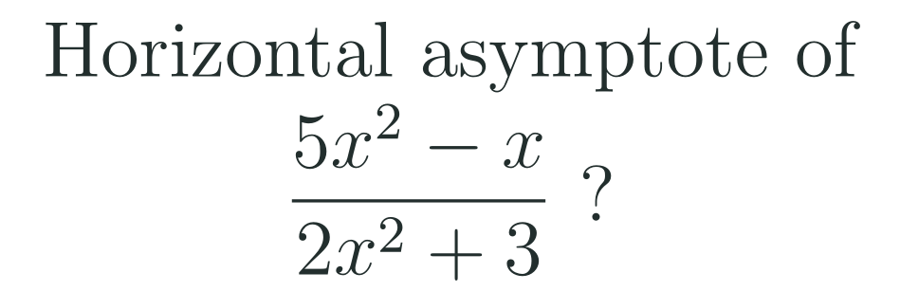
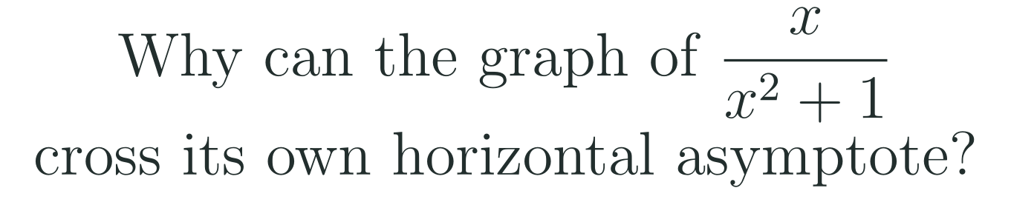
1
2
3
4
5
6
STATION 3 · PRACTICE · 12 MIN
Give it a go: Practice, Apply, Investigate
PRACTICE
APPLY
INVESTIGATE
Secure the method
Use it in context
Find out why
Done when: the limit is written in full notation and the leading terms are named.
Done when: you state the asymptote and say which two leading terms you compared.
Done when: your explanation says what an asymptote describes and points to a value of x.
LO 1.7.A
FAITH, RIGHTEOUSNESS AND WISDOM
Mr Malek Thiab · 8
Notes:
Speaker notes (Practice, 12 min; tierless differentiation: students choose the starting column and may move across):
Speaker notes (Practice, 12 min; tierless: students choose the starting column and may move across).
Answers: Practice: ratio 6x^2 over 3x^2 = 2, so the limit is 2 and y = 2. Apply: ratio 5/2, y = 5/2. Investigate: a horizontal asymptote describes behaviour for large |x| only; at x = 0 the function equals 0, which is its asymptote value, so it crosses there.
Verbal misconceptions: 'asymptotes are walls the graph cannot touch'.
Adaptive routing: finished students move to Apply then Investigate; stuck students return to slide 6.

Slide 9
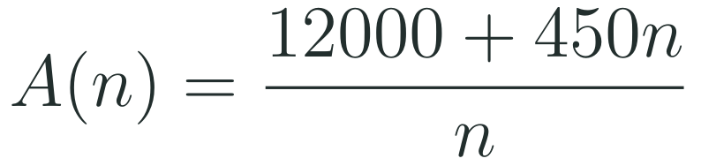

1
2
3
4
5
6
STATION 4 · PRODUCTION · 12 MIN
Production: cost per batch at a bottling plant
THE MODEL
DONE WHEN
A bottling plant produces drinks in batches. The model below uses a fixed set-up cost and a cost per batch. The numbers are model values for practice, not real plant costs. A(n) is the average cost per batch, in dollars, after n batches.
The limit is written in limit notation with units (dollars).
Both averages are given to the nearest dollar.
The equation for 500 dollars is solved in two clear steps.
The meaning of 450 is explained in one sentence.
Find the limit of A as n grows without bound and say what it means.
Find A(100) and A(1000).
Find how many batches give an average cost of 500 dollars.
Hint: write A(n) as 450 plus a fraction, then think about the fraction as n grows.
LO 1.7.A
FAITH, RIGHTEOUSNESS AND WISDOM
Mr Malek Thiab · 9
Notes:
Speaker notes (Production, 12 min):
Speaker notes (Production, 12 min).
Solutions: A(n) = 450 + 12000/n. Task 1: the fraction tends to 0, so the limit is 450 dollars: the cost per batch never falls below the 450 dollar variable cost. Task 2: A(100) = 570 dollars; A(1000) = 462 dollars. Task 3: (12000 + 450n)/n = 500, so 12000 + 450n = 500n and n = 240 batches.
Verbal misconceptions: 'the average cost reaches 450 after enough batches' (it only approaches 450); cross-multiplying incorrectly.
Adaptive routing: if students cannot start, send them to slide 5 Example B (leading terms) and the hint.

Slide 10
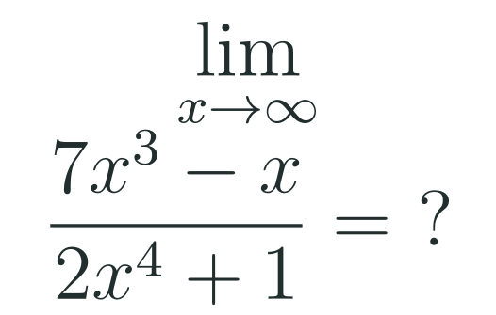
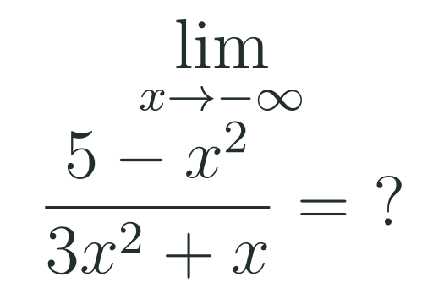
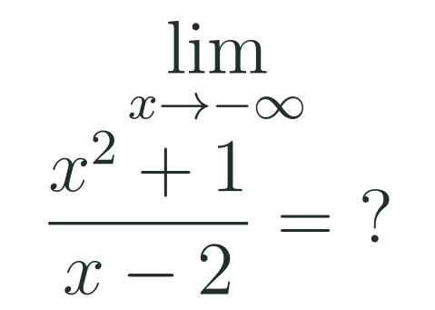
1
2
3
4
5
6
STATION 5 · MASTERY GATE · 6 MIN
Mastery Gate: three questions to pass
1
2
3
Pass mark
3 of 3 correct unlocks Station 6. Fewer than that: return to the slide for the question you missed, redo it, then re-take the gate.
LO 1.7.A
FAITH, RIGHTEOUSNESS AND WISDOM
Mr Malek Thiab · 10
Notes:
Speaker notes (Mastery Gate, 6 min, no calculator):
Speaker notes (Mastery Gate, 6 min, no calculator).
Answers: Q1 0 (numerator degree 3, denominator degree 4). Q2 -1/3 (ratio of leading coefficients -1 and 3). Q3 negative infinity (leading terms x^2/x = x, and x tends to negative infinity).
Verbal misconceptions: Q1 'the larger number 7 beats 2 so the limit is 7/2'; Q2 'drop the minus sign'; Q3 'infinity over infinity is 1'.
Adaptive routing: Q1 missed, route to slide 6; Q2 missed, route to slide 5 Example A; Q3 missed, route to slide 6 Example A.

Slide 11
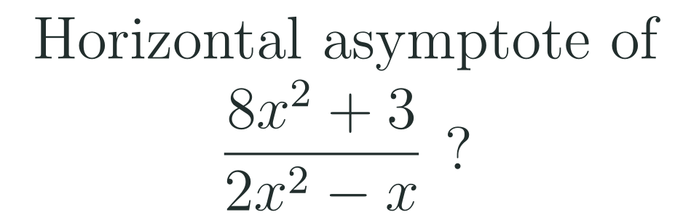
1
2
3
4
5
6
STATION 6 · SMART PRODUCTION · 6 MIN
Smart Production: make one, then check it
CREATE
TIME TO CHECK
Write a rational function whose horizontal asymptote is y = 3.
Write its limit in limit notation on the back.
Swap with a partner: they name both leading terms and check the asymptote.
Exit ticket: write your answer on a sticky note and place it on the door.
Done when: your partner confirms the degrees, the ratio of leading coefficients and the asymptote.
Next lesson: Topic 1.8 Equivalent Representations of Polynomial and Rational Expressions.
LO 1.7.A
FAITH, RIGHTEOUSNESS AND WISDOM
Mr Malek Thiab · 11
Notes:
Speaker notes (Smart Production, 6 min):
Speaker notes (Smart Production, 6 min).
Exit answer: 8x^2 over 2x^2 = 4, so y = 4.
Verbal misconceptions: students write 8/2x or give y = 3 from the constants. Ask: which terms matter when x is huge?

Slide 12
Journey complete
Targeted Instruction
Production
Smart Production
✓
✓
✓
✓
✓
✓
Diagnose
Practice
Mastery Gate
Compare the leading terms: smaller degree on top gives zero, equal degrees give the ratio, larger degree on top has no horizontal asymptote.
FAITH, RIGHTEOUSNESS AND WISDOM
Notes:
Speaker notes: Every station is checked off. Recap in one sentence: Compare the leading terms: smaller degree on top gives zero, equal degrees give the ratio, larger degree on top has no horizontal asymptote. Collect the Time to Check responses. Next lesson: Topic 1.8 Equivalent Representations of Polynomial and Rational Expressions.

